Slide 1
Judiciary Information Management System

Slide 2
Judiciary of Hawai`I
Two Separate Court Systems:
Federal Court System – Handles cases under U.S. federal law.
State Court System – Handles cases under Hawai`i state law (funded by the state Legislature).
State Court System (Managed by JIMS) :
    -> Appellate Courts (Statewide, based in Honolulu) :-
              - Hawai`i Supreme Court
        - Intermediate Court of Appeals
  -> Trial Courts (Four Judicial Circuits)
  - First Circuit – O`ahu & other islands not in another circuit
  - Second Circuit – Maui, Molokai, Lanai, Kaho`olawe, Molokini
  - Third Circuit – Hawai`i (Big Island)
  - Fifth Circuit – Kauai & Niihau

Slide 3
Hawai`i State Court System
Chief Justice of the Supreme Court – Oversees the administration of all courts.
Types of Courts & Their Purpose :
Supreme Court – The highest court, final authority on state law.
                Intermediate Court of Appeals – Hears most appeals from trial courts and state agencies.
                Circuit Courts – Handles major civil and criminal cases, including jury trials.
                District Courts – Handles traffic violations, minor criminal cases, and civil cases under $40,000.
                Family Court – Resolves cases involving families and children.
                Land Court – Oversees land title registration and disputes.
                Tax Appeal Court – Handles tax-related disputes and appeals.

Slide 4
Judiciary Information Management System (JIMS)
JIMS – Judiciary Information Management System, the case management system for the Judiciary.
Applications Under JIMS:-
JIMS Portal – Main access point for Judiciary services.
JEFS – Judiciary Electronic Filing and Service System.
eCourt Kokua (eCK) – Case search and access system.
-> Internal eCourt Kokua – For Judiciary staff.
-> External eCourt Kokua – For public access.
-> Kiosk – Public self-service access to case information.
In-Court Processing (ICP) – Real-time court case management.
JIMS Oracle Forms – Database management tool for Judiciary operations.
eReminder – Notification system for court dates.
-> Internal eReminder – For Judiciary staff.
-> External eReminder (Self-Registration Portal) – For public users.

Slide 5
JIMS Portal – Official Case Management System
JIMS Portal – The official court record system, accessible only to Judiciary staff.
Primary Users:
Court clerks, legal document branch, judicial assistants, court administrators, supervisors, and judges.
Courts Managed in JIMS Portal:
                -> Supreme Court
-> Intermediate Court of Appeals
-> Circuit Court – Criminal & Civil Cases
-> District Court – Traffic, Criminal & Civil Cases
-> Family Court – Criminal Cases
Key Features:
-> Manages case records and documents.
-> Functions grouped into Pods based on user roles.
-> Court supervisors control user access based on duties.
Note:
-> Criminal Law – Handles crimes against the government.
-> Civil Law – Resolves disputes between private parties.

Slide 6
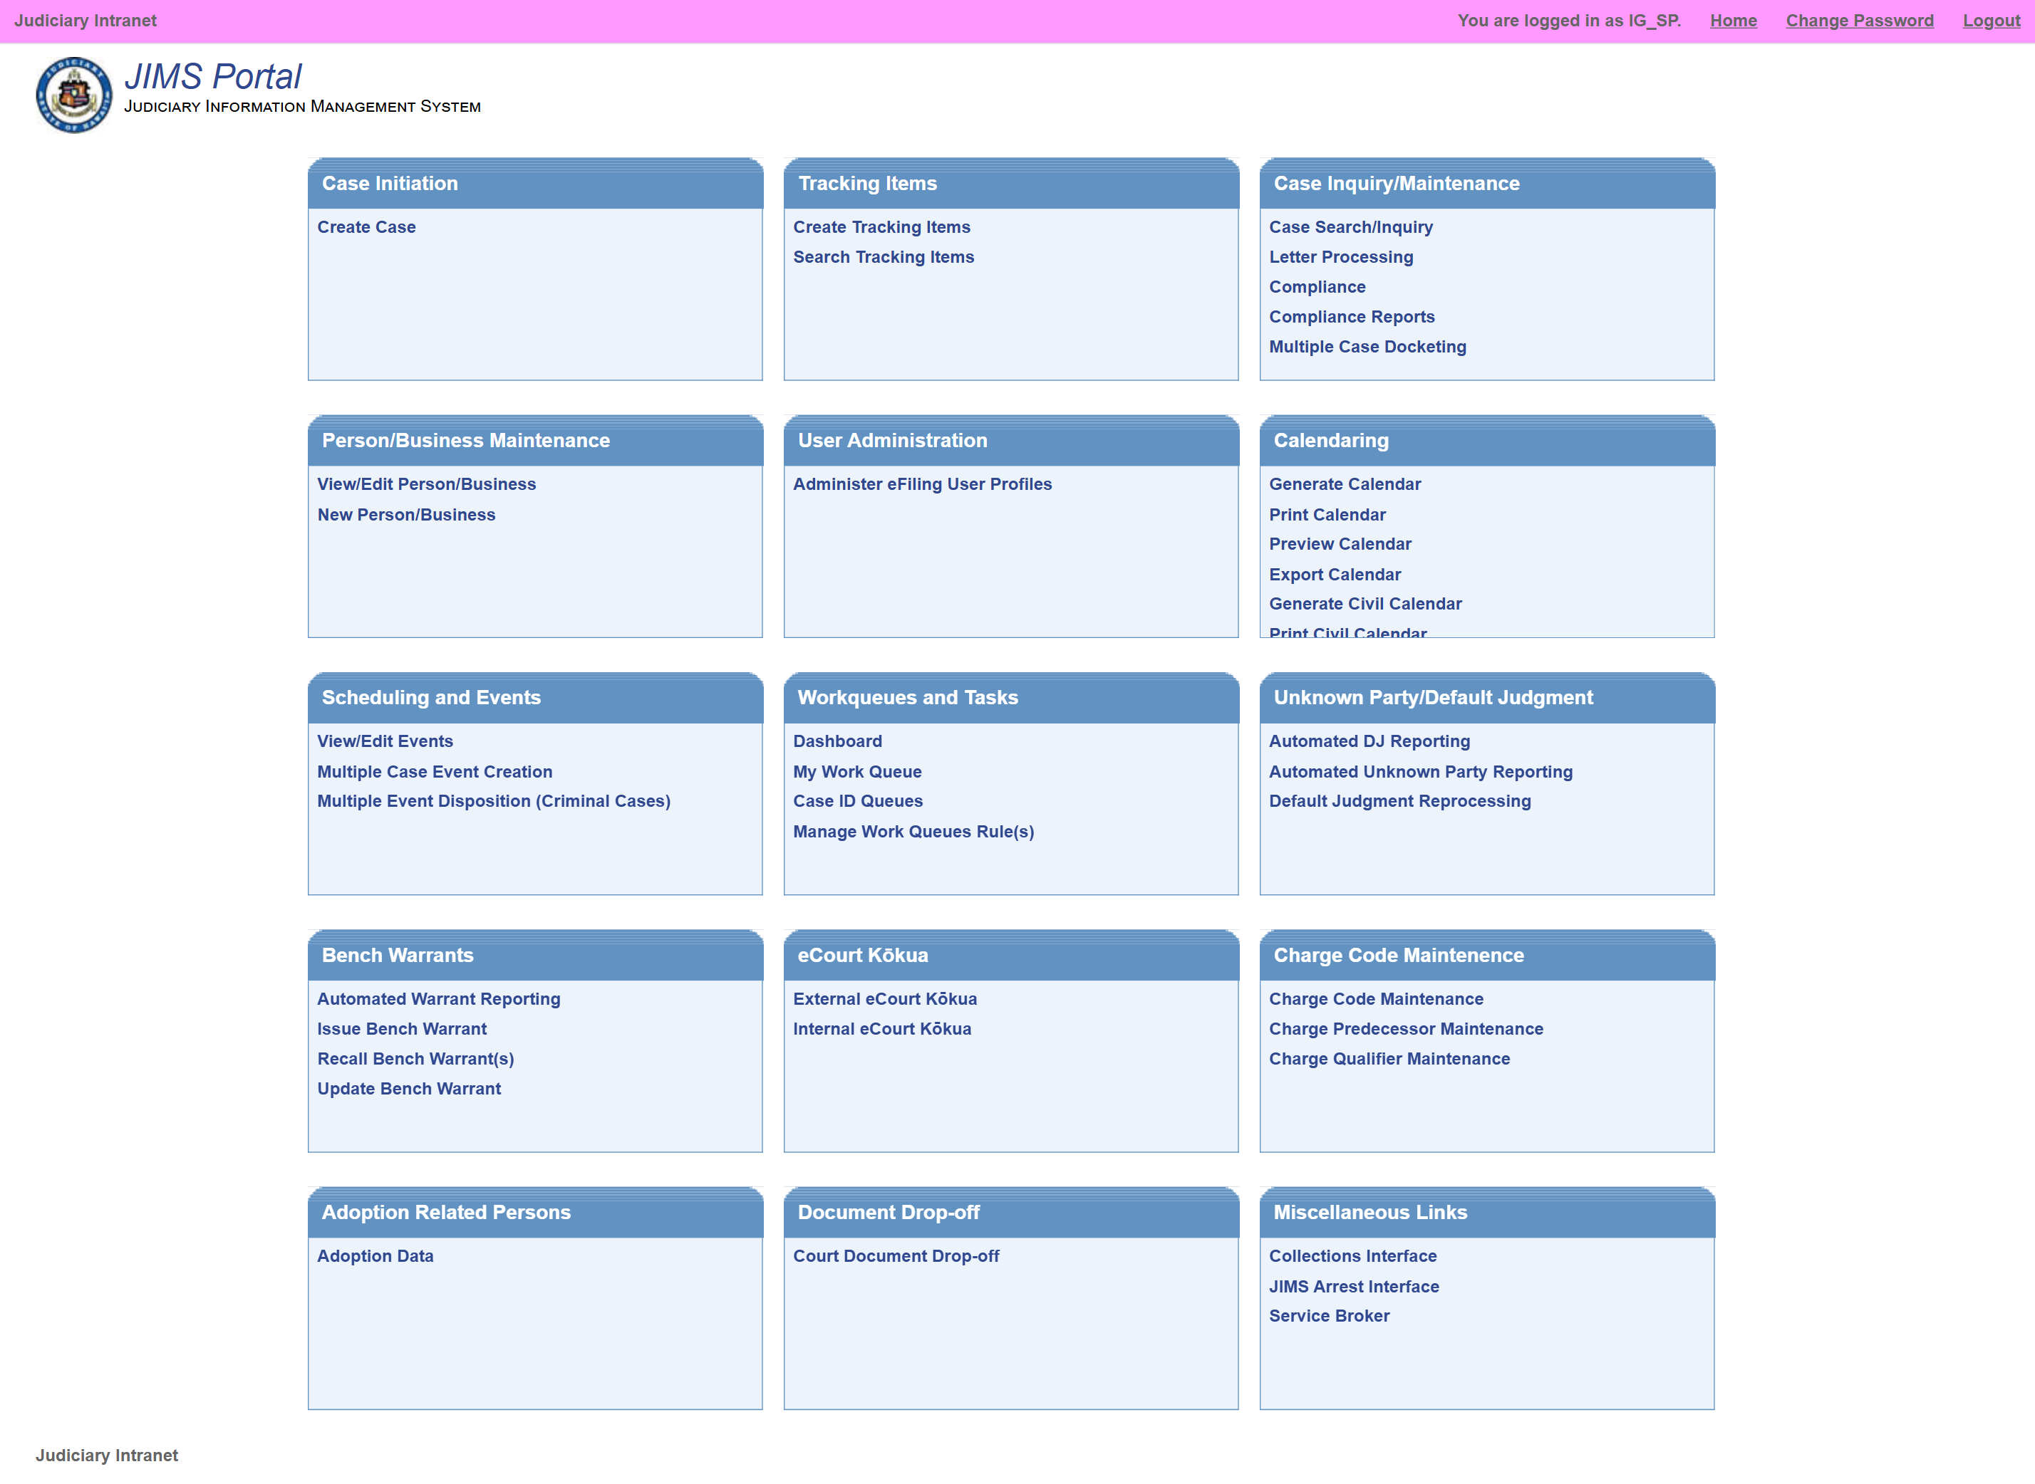

Slide 7
Primary Functions of JIMS Portal
Case Initiation
Tracking Items
Case Inquiry/Maintenance
Work Queue and Tasks
Calendaring
Bench Warrants
User Administration
eCourt Kokua
Scheduling & Events
Adoption
Person/Business Maintenance
Charge Code Maintenance
Interfaces
Unknown Party/Default Judgment

Slide 8
Criminal Case Flow
(with an example case)

Slide 9
Criminal Case Flow – How a Criminal Case Proceeds
Kamlesh is caught stealing a motorcycle and is arrested. The prosecutor reviews the case and initiates the criminal case in one of two ways:
Criminal Written Complaint – If the prosecutor files formal charges.
Criminal Citation – If Kamlesh was caught in a minor offense and released with a court summons.
How the Case Moves in District Court (Single Defendant Cases):-
  Kamlesh is arrested and held in custody until his court hearing.
  First Court Event : Preliminary Hearing
    The judge checks if there is enough evidence (probable cause) to continue.
    If no probable cause, Kamlesh is released (case dismissed).
    If probable cause is found, the case moves forward.
  Next Event: Arraignment & Plea
    Kamlesh is asked to plead guilty or not guilty.
    If guilty, the judge sets a sentencing date.
    If not guilty, the case moves to trial.
  Trial Process
    A pre-trial agreement may resolve the case.
    If no agreement is reached, a bench trial is scheduled.
    If motions and pleadings settle the case, it ends before trial.
    Otherwise, Kamlesh faces trial where the judge decides the outcome.
-> JIMS tracks every stage, from case filing to final judgment!

Slide 10
Case Initiation – How a Criminal Case Starts
Once the prosecutor files a Criminal Written Complaint or Criminal Citation, the court staff use the Create Case function to register the case in the system. This is where case initiation begins in the Judiciary Information Management System (JIMS).
Criminal Case Details Required:
  Basic Case Information: Depends on whether the case is in Circuit, Family, or District Court.
  Defendant Information: Kamlesh, who was arrested, is added as the defendant.
  Plaintiff: The system automatically lists the State as the plaintiff since criminal cases are offenses against the government.
  Charges: At least one violation (for District Court cases) or offense (for Circuit/Family Court cases) is recorded.
-> This marks the official start of Kamlesh’s case, enabling further court proceedings.

Slide 11
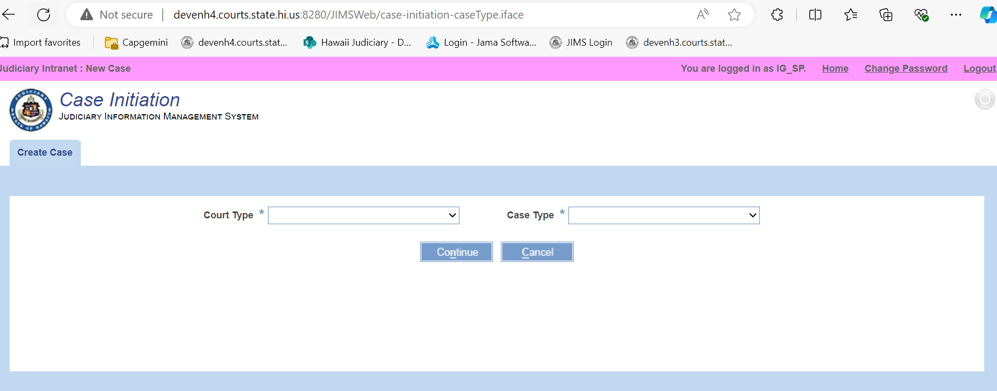
Court Types & Case Types
When a case is initiated, the court type determines which case type can be selected:
-> Circuit Court (CC): Handles both civil and criminal cases, including serious felonies.
-> District Court (DC): Handles both civil and criminal cases, including misdemeanors.
-> Family Court (FC): Handles family-related civil and criminal cases (e.g., juvenile offenses, domestic violence).
-> Intermediate Court of Appeals (ICA): Handles Appeals (AP), Other (OT), and Agreed Statement (ST) case types.
-> Supreme Court: Handles constitutional matters, final appeals, and high-profile cases.

Slide 12
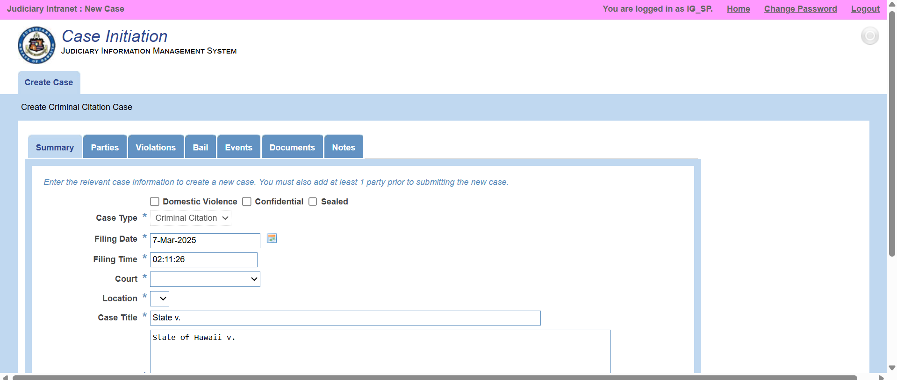
After selecting the court type and case type, clicking "Continue" will open various tabs where important case details are entered:
-> Summary Tab: Displays key case details.
-> Parties Tab: Adds defendants, attorneys, and other involved parties.
-> Violation Tab: Captures offense details, statutes violated, and police report numbers.
-> Events Tab: Logs hearings, arraignments, and trials.
-> Dockets Tab: Stores legal documents, filings, and orders.
-> Notes Tab: Records additional case-related information.

Slide 13
Case Inquiry/Maintenance – Continuing Kamlesh’s Case
After Kamlesh’s case is initiated in the system, court staff use the Case Inquiry/Maintenance function to track and manage all updates related to his case.
Case Search & Maintenance: Court staff can search for Kamlesh’s case using his name, case number, or other identifiers. Once retrieved, they can add new details like additional charges, attorneys, or schedule upcoming hearings.
Scheduling Court Hearings: If Kamlesh pleads not guilty, court staff use this function to schedule pre-trial hearings, trial dates, and other necessary proceedings.
Docketing Additional Documents: Any new legal filings, such as motions submitted by the defense attorney or prosecution, are uploaded under the Dockets Tab to maintain an official record.
On-Demand Printing (ODP) Documents: If the judge issues a summons for a witness or an order for Kamlesh’s release, the system generates preformatted court documents, which are automatically docketed in his case file.
Compliance & Reports: If Kamlesh’s case is inactive for too long without required legal actions (like missing a court-mandated deadline), staff review compliance reports and issue dismissals if necessary.
This module ensures all court proceedings, from arraignment to trial or dismissal, are documented, scheduled, and legally processed within the system.

Slide 14
Work Queue
As Kamlesh’s case progresses, various legal documents (dockets) are filed by attorneys, court staff, or other involved parties. The Work Queue acts as an inbox where these documents are stored for review and action by court staff.
My Work Queue: If a court clerk is assigned to Kamlesh’s case, any documents requiring their attention (like a motion filed by the defense) will appear in their personal work queue.
Case ID Queue: Court staff can search for Kamlesh’s case directly by its Case ID and view all pending tasks related to it, such as scheduling a hearing or updating a ruling.
Manage Work Queue Rules: Supervisors set up rules to ensure that critical tasks—such as reviewing a new evidence submission—are automatically assigned to the right court personnel.
The Work Queue ensures that every necessary action in Kamlesh’s case, from reviewing legal filings to scheduling hearings, is handled promptly and efficiently.

Slide 15
Calendaring – Scheduling Kamlesh’s Court Hearings
Once Kamlesh’s case moves forward, the court staff schedules hearings and trials using the Calendaring function.
This ensures that all upcoming events are properly documented and organized.
Scheduling Court Events: Before a court hearing, staff schedule the preliminary hearing, arraignment, and trial dates in the system. For example, Kamlesh's arraignment & plea hearing is scheduled in the District Court.
Generating Court Calendar: Once scheduled, the system generates a daily court calendar showing all hearings for a specific day, categorized by courtroom and division.
Printing the Calendar: Court clerks print the official court calendar (PDF) for judges, attorneys, and other staff to prepare for the day's proceedings.
With Calendaring, all of Kamlesh’s court events—from preliminary hearings to final sentencing—are systematically planned and accessible to authorized staff.

Slide 16
Bench Warrant – Handling Kamlesh’s Missed Criminal Court Appearance
If Kamlesh fails to appear for his scheduled criminal case hearing, the judge may order a bench warrant for his arrest.
The court staff then uses the Bench Warrant function to officially issue and track the warrant.
Issuing a Bench Warrant (Criminal Case - BWC):
                -> Since Kamlesh missed his criminal court appearance, the court issues a Bench Warrant – Criminal (BWC).
          -> The system generates and dockets the warrant under Kamlesh’s case.
Managing Bench Warrants:
    -> Recall Warrant: If Kamlesh later appears in court or provides a valid reason, the judge may recall the warrant, and the staff updates the system accordingly.
  -> Update Warrant: If any details of the warrant change (e.g., bond amount, conditions), the staff can update the warrant details in the system.
With the Bench Warrant function, the court ensures that defendants like Kamlesh cannot evade justice by missing their scheduled hearings.

Slide 17
User Administration – Managing Court System Access for Kamlesh’s Case
The User Administration function ensures that only authorized court personnel can access and manage cases, including Kamlesh’s criminal case.
E-Filing User Profiles:
  -> Court supervisors manage electronic filing (JEFS) user profiles, ensuring that attorneys, prosecutors, and court staff have the right access to file and retrieve documents.
  -> If Kamlesh’s attorney needs access to submit motions or evidence, their profile is configured by the admin.
In-Camera Access for Judges’ Staff:
-> Some case documents may be sensitive or confidential (e.g. sealed evidence, witness identities).
-> Judges can grant their staff (court clerks, judicial assistants) permission to view in-camera documents related to Kamlesh’s case.
With User Administration, the court ensures secure, role-based access to sensitive case information, maintaining data privacy and judicial efficiency.

Slide 18
eCourt Kokua – Public & Internal Access to Kamlesh’s Case
eCourt Kokua is a read-only portal that enables court staff and the public to view case details while ensuring security and transparency.
Types of eCourt Kokua Access:
Internal eCourt Kokua – Used by court staff to access Kamlesh’s case details, review court events, and obtain certified documents. Judges can also view Judge’s Exhibit for criminal history.
External eCourt Kokua – Attorneys, prosecutors, and the public can search for and view non-confidential case details (e.g., Kamlesh’s next hearing date). Documents can be purchased as certified or non-certified copies.
Kiosk Access – Available at designated courthouse kiosks, allowing individuals to check case statuses without logging into the internal system. Documents can be viewed but must be purchased over the counter.
JEFS Document Subscription – Attorneys and registered users can subscribe for automated updates on Kamlesh’s case, ensuring they receive notifications for filings, motions, and court orders.
With eCourt Kokua, court information remains accessible, organized, and transparent, supporting fair trial procedures for Kamlesh and all involved parties.

Slide 19
eCourt Kokua – Versions & Differences
Internal eCourt Kokua
Used by court staff for viewing case details and court events via calendar search.
Judges have access to Judge’s Exhibit for criminal case details.
Allows retrieval of certified documents based on user permissions.
Designed for JIMS users, inheriting their security permissions.
External eCourt Kokua
Public access to non-confidential cases and documents.
Users must purchase documents (two types available):
-> Non-certified copies
-> Certified copies (priced higher)
Purchased documents can be downloaded as PDFs.
eCourt Kokua Kiosk
Available only in courthouses at designated kiosks.
Public can view non-confidential cases & documents without purchasing.
For printed copies, users must approach court staff for purchase.
JEFS Document Subscription
Subscription-based access to case documents.
No additional pay-per-document charges for subscribers.
Similar to External eCourt Kokua but includes document access in the plan.

Slide 20
Scheduling and Event Management – Kamlesh’s Case
Kamlesh is involved in a criminal case, and proper scheduling of court events is crucial for ensuring a smooth judicial process.
The Scheduling and Event Management functionality helps court staff manage all hearings and proceedings related to his case.
How Scheduling Works in Kamlesh’s Case:
Pre-Scheduled Events – Kamlesh’s arraignment and trial hearings are scheduled in the system.
Cancel Events – If a preliminary hearing is no longer needed due to a plea deal, it can be canceled.
Edit Events – If the trial date needs to be postponed due to new evidence, the staff can modify the schedule.
Associate Case Dockets – Any new motions filed by Kamlesh’s attorney (e.g. a motion to dismiss evidence) can be linked to his upcoming court hearing.
Generate Amended Notice – If Kamlesh’s court date changes, the system generates an updated notice automatically.
-> Delete Events – If an unnecessary hearing was scheduled in error, it can be removed.
-> Copy Events – If a status hearing is needed on a future date, staff can duplicate the existing event, ensuring consistency.
This functionality ensures that Kamlesh’s criminal case proceedings are accurately managed, keeping all parties informed and reducing scheduling conflicts.

Slide 21
Tracking Items – Managing Judicial Documents in Kamlesh’s Case
Tracking items are official court documents signed by judges or clerks, maintained as paper records.
These documents are not directly linked to any specific case in JIMS, but they play a crucial role in judicial operations.
Types of Tracking Items Relevant to Kamlesh’s Criminal Case:
Search Warrants – If law enforcement needs to search Kamlesh’s residence for evidence, they must obtain a search warrant signed by a judge.
Arrest Warrants – If Kamlesh fails to appear for a scheduled court hearing, an arrest warrant may be issued.
Administrative Warrants – If the court requires additional actions outside of a criminal case, such as enforcing compliance with a court order, an administrative warrant may be generated.
Tracking Item Operations:
Create Tracking Items – A new search warrant can be issued for an investigation related to Kamlesh’s case.
Search Tracking Items – Court staff can retrieve and verify past warrants or judicial orders related to Kamlesh.
This system ensures that important judicial documents are efficiently recorded and retrieved, helping maintain accountability and due process in Kamlesh’s case.

Slide 22
Adoption Case Management
When a family adopts a child, they must file an adoption case with the judiciary.
The court clerk then creates an adoption case under the Family Court, ensuring all necessary details are documented.
Key Adoption Case Details:
Court Type: Family
Case Type: Adoption
Confidentiality: By default, adoption cases are marked as confidential to protect privacy.
Steps in Adoption Case Creation:
Filling Mandatory Fields – The party details, dockets, and summary fields must be completed.
Submitting the Case – Once submitted, the system creates an adoption case in JIMS.
Searching for Adoption Cases:
Search by Case ID – Users can retrieve adoption cases by entering the unique case ID.
Search by Person – The system allows searches based on the individual's name, linking them to any adoption records.
Access Control:
Restricted Access – If a court user does not have permission, they cannot view adoption-related records, ensuring sensitive data is protected.
This system maintains privacy and efficiency in adoption cases while ensuring compliance with judicial procedures.

Slide 23
Person/Business Maintenance – Kamlesh’s Case
As part of Kamlesh’s criminal case, his personal details need to be accurately recorded and maintained in the system.
How This Functionality is Used in Kamlesh’s Case:
Adding details to the System – When Kamlesh was first involved in the case, his details (name, date of birth, address, and other identifiers) were added to the court system.
Modifying Details – If Kamlesh's address changed or there was an update in his legal representation, court staff could edit his information to ensure accuracy.
Merging Party IDs – If there were multiple records for Kamlesh due to past cases or clerical errors, the system allowed merging duplicate entries into a single profile, ensuring consistency across judicial records.
By maintaining accurate and updated details for Kamlesh, the system ensures seamless case tracking, proper legal notifications, and efficient court proceedings.

Slide 24
Charge Code Maintenance
In Kamlesh’s criminal case, the charge code maintenance functionality ensures that all charges against him are properly recorded and categorized based on their severity.
How This Functionality is Used in Kamlesh’s Case:
Assigning Charge Codes – When Kamlesh was charged, the system assigned specific charge codes based on the nature of the offense or violation (e.g., misdemeanor, felony, or traffic violation).
Severity Level Classification – The charge codes were categorized by severity, ensuring the correct legal procedures and penalties were applied.
Updating Charges – If additional charges were filed against Kamlesh or if charges were modified/dropped, the court staff could update the charge code details accordingly.
Tracking Offenses & Violations – The charge code maintenance pod allowed legal professionals to review and reference the charges against Kamlesh, ensuring transparency and proper judicial handling.
By maintaining accurate charge codes, Kamlesh’s case is processed efficiently, ensuring fairness in legal proceedings.

Slide 25
Default Judgment (DJ)
In Kamlesh’s criminal case, a Default Judgment (DJ) was issued due to his failure to appear in court for his scheduled hearing.
How DJ Functionality is Applied in Kamlesh’s Case:
Failure to Appear – Kamlesh missed his court hearing, triggering the system to process a Default Judgment against him.
DJ Generation & Notification – A PDF document was generated automatically, summarizing the court’s ruling against Kamlesh, and sent to his last known address.
Batch Processing for Multiple Cases – If Kamlesh’s case was part of a batch process, the system processed multiple Default Judgments at once, ensuring efficiency.
Tracking & Verification – The DJ processing job ID was recorded in the system, allowing court staff to track its success through the summary report.
Viewing & Reprocessing – If needed, the DJ document could be viewed under the maintenance docket tab or reprocessed if corrections were required.
The Default Judgment ensured that even in Kamlesh’s absence, the court proceedings continued as per the legal framework.

Slide 26
Interfaces
In Kamlesh’s criminal case, several batch jobs were utilized to ensure smooth court operations and timely processing of documents, notifications, and judgments.
Key Batch Jobs and Their Role in Kamlesh’s Case:
Document Pollar – Automatically retrieved and processed legal documents related to Kamlesh’s case, ensuring they were available in the system.
Notification Pollar – Sent court hearing reminders and updates to Kamlesh via registered communication channels. If he failed to respond, it escalated the process leading to a Default Judgment (DJ).
Calendar Pollar – Managed the scheduling of Kamlesh’s hearings and updated court staff and attorneys regarding any modifications.
DJ Pollar – Once Kamlesh failed to appear in court, this job triggered the generation of his Default Judgment (DJ), ensuring timely legal actions.
All these batch jobs ran on a scheduled execution pattern, ensuring court operations were automated, efficient, and adaptable based on real-time requirements.

Slide 27
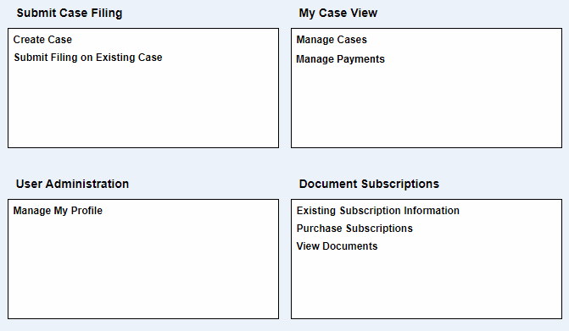
JEFS Portal

Slide 28
Judiciary Electronic Filing and Service System
JEFS (Judiciary Electronic Filing and Service System) – Key Functionalities:-
Electronic Case Filing: Allows attorneys registered with the Hawaii State Bar Association to create and manage cases.
Document Submission: Attorneys and authorized firm staff can file legal documents electronically.
Role-Based Access: Attorneys control access for their firm staff, ensuring accountability.
Judiciary Integration: Submitted documents are directly integrated into the court system for processing.
Efficient Notification System: Users receive updates on case filings, motions, and court orders.
Secure Access: Only registered attorneys and their designated staff can utilize the system.
This system streamlines legal case management, reducing paperwork and enhancing efficiency in court operations.

Slide 29
Submit Case Filing
Creating a Criminal Case
-> Only Attorney General & Prosecutors can create criminal cases.
->Attorneys can create cases in Supreme Court, ICA, and civil courts.
Filing on an Existing Case
-> Attorneys & their staff can submit filings on active cases.
-> Criminal cases: Filings allowed on active cases & cases closed within 90 days.
-> Civil cases: Filings allowed irrespective of case status.
Self-Represented Filings
-> Allowed in criminal cases upon court approval.
-> Self-represented parties can file civil cases from Q4 2019.
Outcome
-> JEFS ensures structured, transparent, & efficient case management.

Slide 30
My Case View
Manage Cases
-> View documents on active cases and those closed within 90 days.
-> Add parties and view events related to the case.
-> Not an attorney’s personal case repository—only recent cases are available.
-> Law firm staff can access case information from colleagues’ active cases if at least one member of the firm is involved.
Manage Payments
-> Attorneys & staff can pay outstanding filing fees for Civil cases.
-> Part of the Civil Project implementation.
Outcome
-> Efficient case tracking, collaboration, and payment management for attorneys.

Slide 31
User Administration
Manage My Profile
->JEFS users can update personal details as needed.
Outcome
-> Ensures user information is accurate and up to date.

Slide 32
Document Subscription
Purchase Subscriptions
-> Allows attorneys, firm staff, self-represented parties, and the public to subscribe to view court documents for cases they are not associated with.
View Documents
-> Subscribers can access non-confidential documents at no extra cost.
-> Option to obtain certified copies of documents.
Subscription Details
-> Displays existing subscription information for the user.

Slide 33
JIMS/JEFS Payment
Purpose
-> Enables court staff to assess and process civil filing fees for Circuit Civil and Family Civil cases.
Payment Sections
  1. Access Fee – Assess applicable fees.
  2. Process Payment – Handle fee transactions.
  3. Payment History – Track past payments.
Access Restrictions
-> Only authorized users can view and process payments.
-> Unauthorized users won’t see payment options (e.g., pay button hidden)

Slide 34
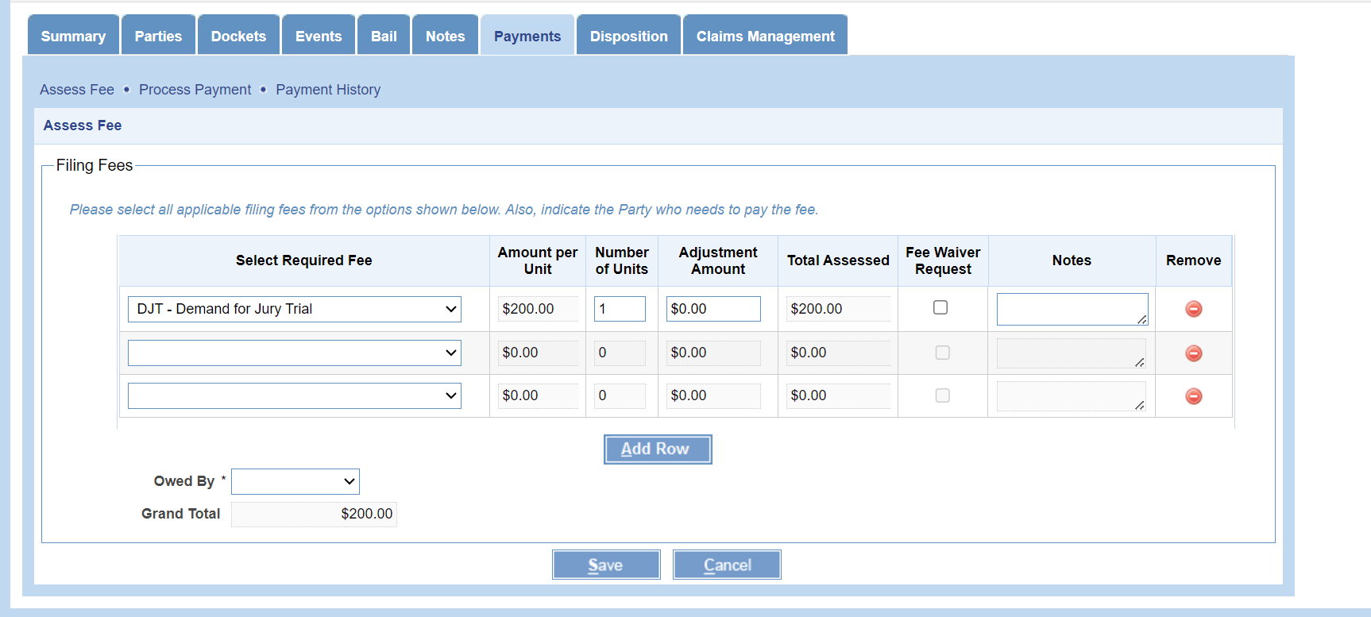
Access Fee
Purpose
-> When a person files a case in court, the judge may require a fee to be paid.
-> Fees are fixed and divided into parts based on predefined units.
Functionality
-> The system calculates the total assessed amount based on the units given.
-> Displays ownership details of the person responsible for paying the fee.

Slide 35
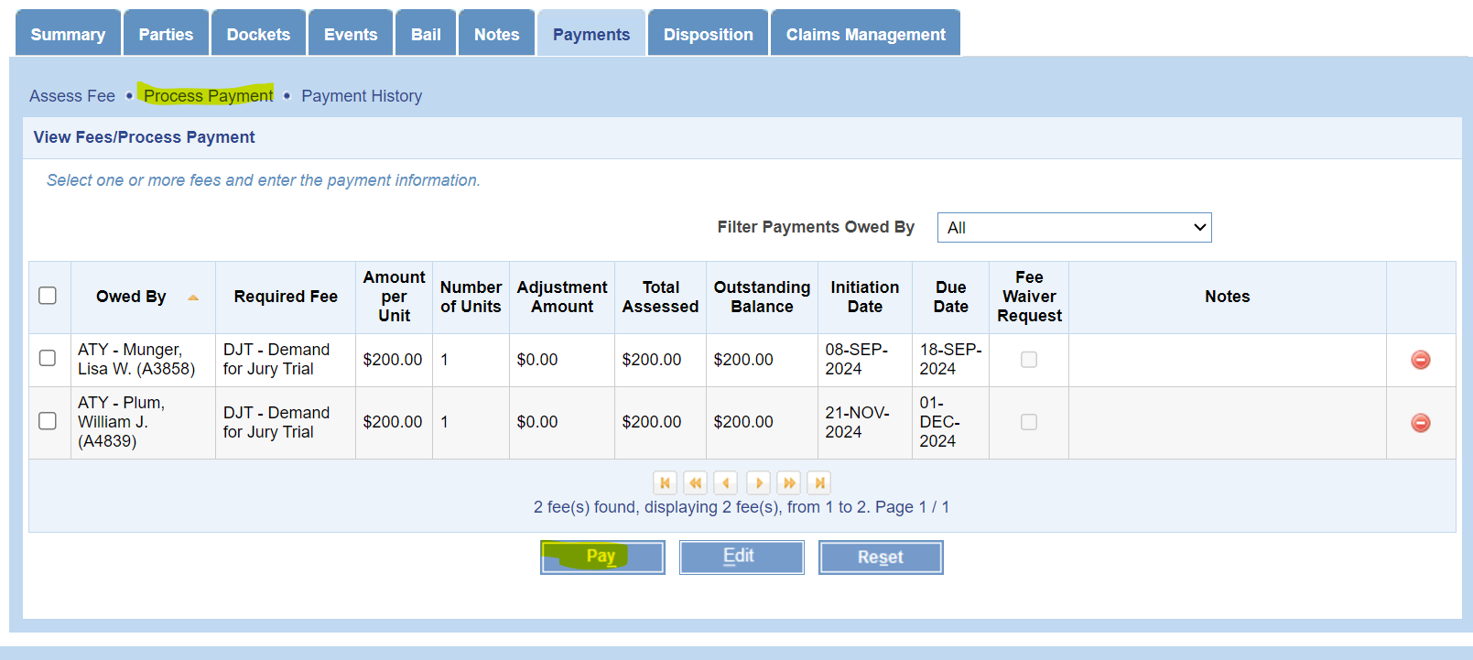
Process Payment
Purpose
-> Facilitates the actual payment process for court fees.
Functionality
-> The payee can make payments using cash, credit card, or debit card.
-> "Pay" button is enabled for authorized users to complete transactions.

Slide 36
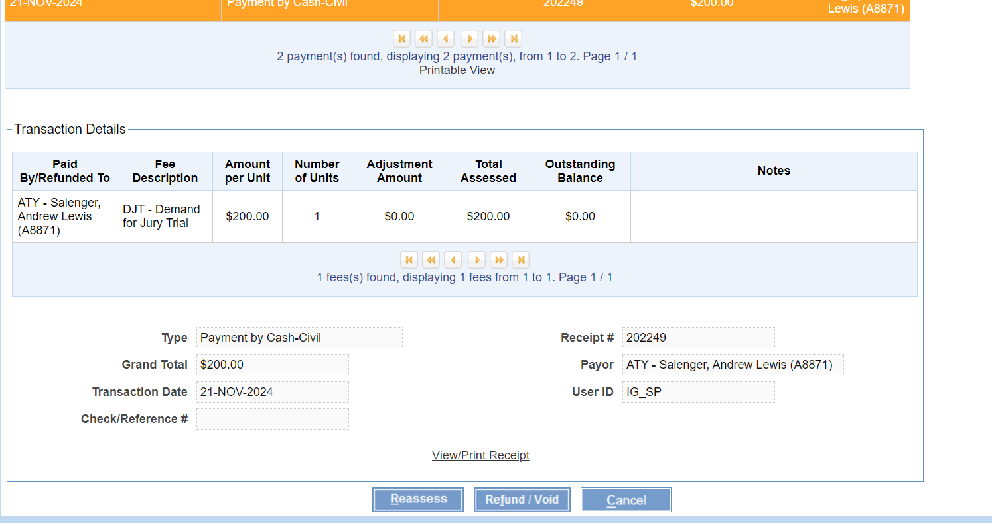
Payment History
Purpose
->Maintains a record of all payments made by the payee for a particular case.
Functionality
-> Stores payment history details for reference.
-> Provides a printable view of the payment receipt for documentation.

Slide 37
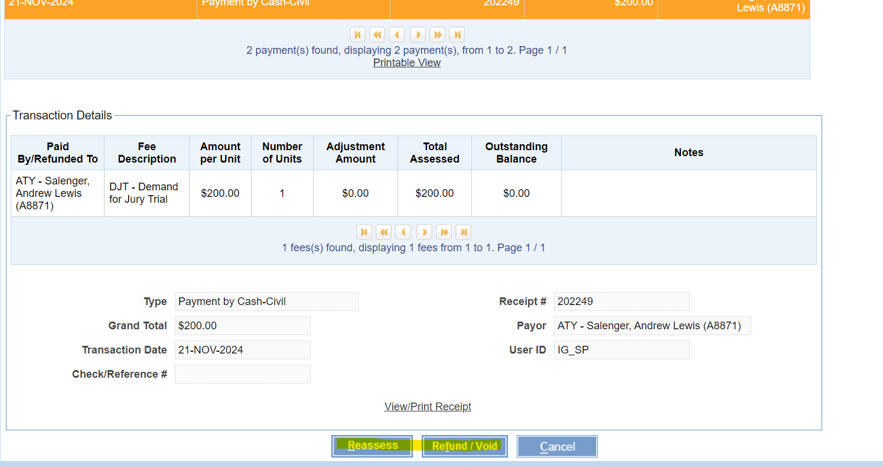
Reassess/Refund
Purpose
-> Handles situations where the paid amount is either less than or more than the actual required amount.
Functionality
-> If the amount paid is less, an outstanding balance is displayed, and the system allows an option to pay later.
-> If the amount paid is more, the system processes a refund based on the selected reason.

Slide 38
In-Court Processing
Purpose
-> Used in District Courts to process criminal cases during live hearings.
-> Enables court clerks to process cases, create orders, judgments, and docket them in real time.
Key Requirements
-> The case must be available in the JIMS portal.
-> An event must be scheduled and calendared.
-> Valid JIMS portal ID for access.
->Case or party details must be available for processing.
Usage
->Handles Criminal Citations, Criminal Written Complaints, and Combination Cases (Traffic + Criminal).
->Designed for live courtroom usage by court clerks.

Slide 39
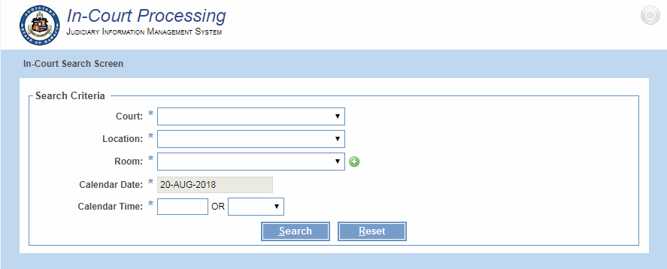

Slide 40
eReminder
Purpose
-> Sends free automated reminders to subscribed recipients about upcoming court hearings.
-> Helps defendants and litigants avoid missing court appearances.
How It Works
-> Reminders are sent via text (SMS) and/or email at 6 AM daily.
-> Subscribers receive three reminders:
        - 7 days before the court date
      - 1 day before the court date
      - On the day of the court date
Types of eReminder Applications
1. Internal eReminder (for Judiciary staff)
2. eReminder Self-registration Portal (for the general public)
Technology Used
-> Uses Twilio’s Programmable SMS service to send text reminders.

Slide 41
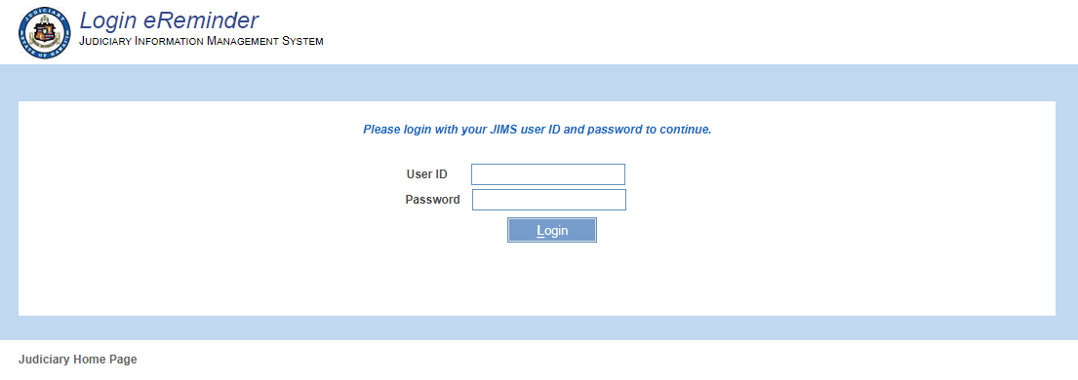
1. Internal eReminder System
Purpose
-> Used by Court Staff to subscribe recipients for court hearing reminders.
-> Helps manage reminders for defendants, litigants, and other interested parties.
Key Features
-> Manual Subscription: Court staff can add recipients who request reminders in person.
-> Subscription Control: Staff can deactivate reminders upon request using a phone number or email.
-> Manage External Subscriptions: Staff can review, modify, or deactivate subscriptions from the Self- registration Portal.
->Restricted Access: Only accessible inside the Judiciary’s network.
Access
-> Court staff log in using JIMS Portal credentials (with necessary permissions).

Slide 42
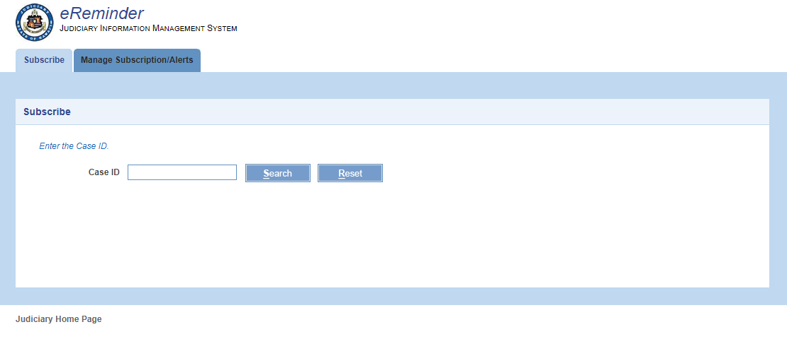
Internal eReminder – Subscription Management
Subscribe
-> Court staff can add recipient’s phone number(s) and/or email(s) to receive eReminders for scheduled court hearings.
Manage Subscription/Alerts
-> Review existing subscription details.
-> Deactivate or reactivate eReminders for a case.
->Manage subscriptions using:
  - Case ID
  - Subscriber’s phone number or email address

Slide 43
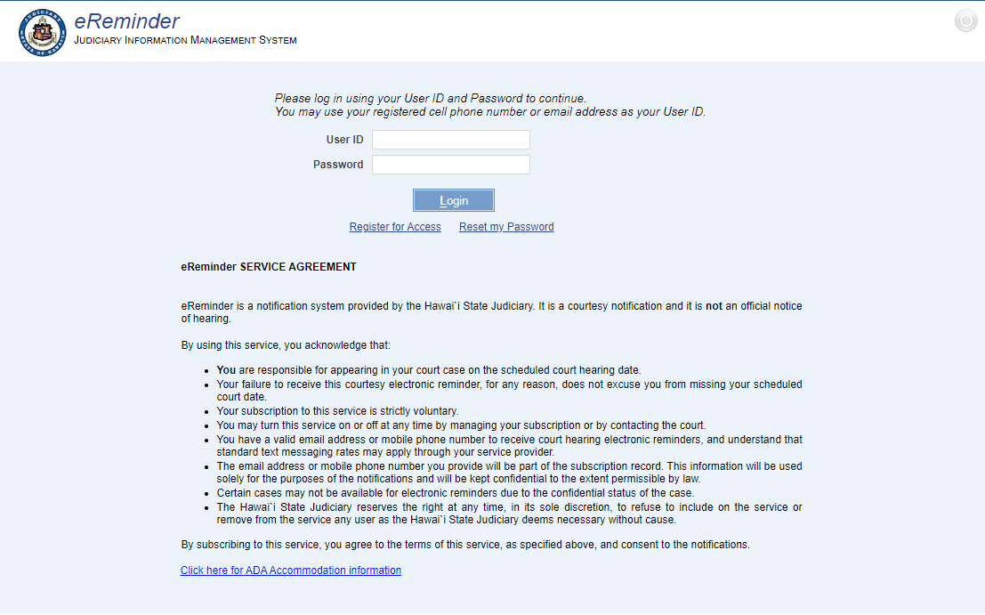
2. eReminder Self-Registration Portal (External eReminder)
Overview
-> Open to the general public for subscribing to court hearing alerts online.
-> No need to visit the court in person.
How It Works
1. Access the Judiciary’s website.
2. Register by creating a profile with a cell phone number and/or email.
3. Verify phone/email to complete registration.
4. Log in to set up and manage court hearing reminders.

Slide 44
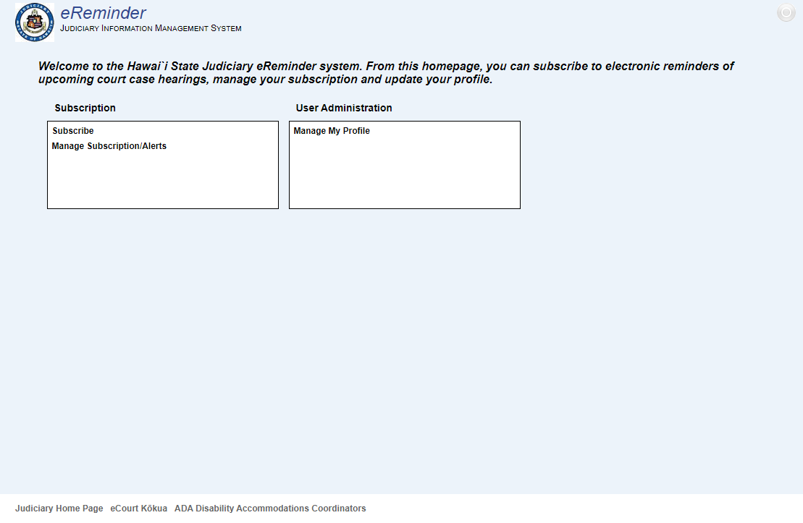
External eReminder - Features
Subscribe
-> Add a Case ID to receive eReminders for scheduled court hearings.
Manage Subscription/Alerts
-> View active & inactive subscriptions.
-> Review, deactivate, or reactivate eReminders for a case.
Manage My Profile
-> Update contact details (phone/email).
-> Requires re-verification for any updated contact information.

Slide 45
Crystal Report
Functionality:
-> Generates PDF documents based on database queries.
-> Executes client-specified queries to fetch and display data.
-> Reports are viewable via web URL and can be scheduled for automatic delivery.
Advantages:
-> Rapid report development
-> Supports interactive charts for complex reports
-> Exports reports in multiple formats: PDF, DOC, XLS, HTML, RTF

Slide 46
THANK YOU!

